Slide 1

QlikView – What’s your business question ?

Slide 2
Agenda
Brief history of QlikView
Why QlikView as compare to other BI Tools
Career Opportunities with QlikView
Advantages of using QlikView
Understanding how companies are adopting QlikView
Hands on Example
Q&A

Slide 3
Brief history of QlikView
Founded in Sweden in 1993 by Björn Berg and Staffan Gestrelius originally as a consultancy
Originally called “QuikView” as in “Quality, Understanding, Interaction, Knowledge”
Product was designed to mimic the way the brain works
First two versions were basically written in Excel using VLOOKUPs
Now has over 24,000 customers in 100 countries and employs over 1,000 people worldwide
Market cap: $2.5 billion

Slide 4
Why QlikView?
Patented in-memory technology
Faster BI solutions development
Complete suite for R&A (Integration -> Modeling -> Presentation)
Associative User Experience

Slide 5
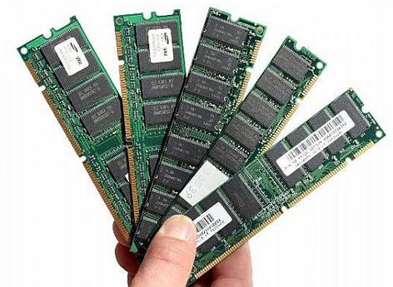

In-Memory Technology

Slide 6
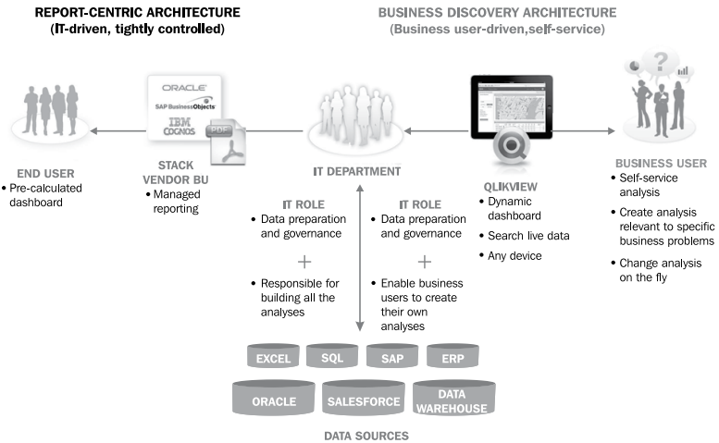
Faster BI Solutions Development

Slide 7
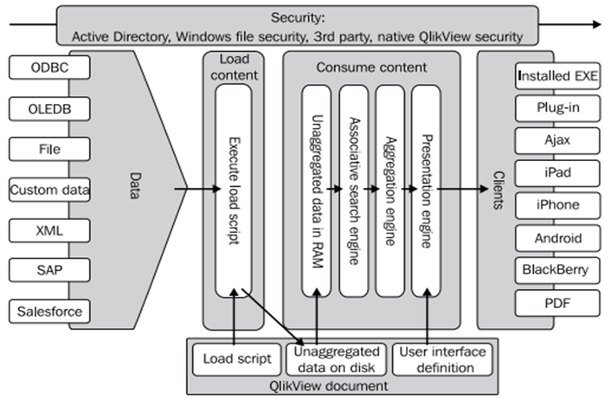
Complete suite for R&A
Integration
Modeling
Presentation

Slide 8
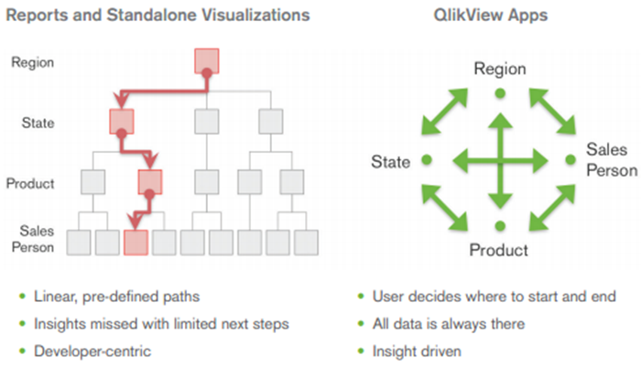
Associative user experience

Slide 9
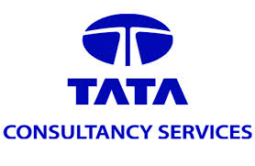


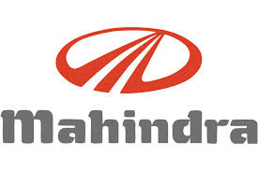

Major Companies using Qlikview

Slide 10
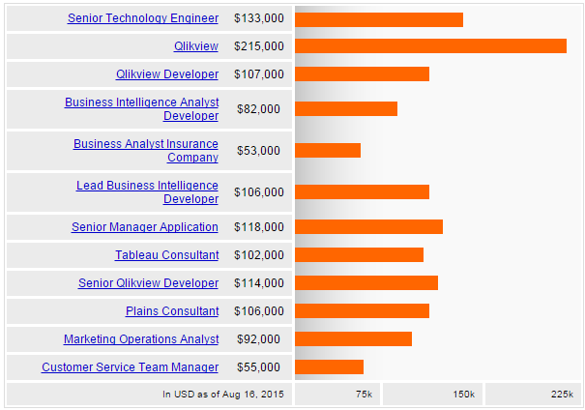
Salary Trends in India
Source: Indeed

Slide 11
Job Trends in India
Source: Naukri.com

Slide 12
Advantages of using QlikView
Down – Top approach of development instead of Top - Down approach of adoption
Analyst & Business Friendly approach of using QlikView
Faster Development & Change Management
Self Service BI for End Users
Minimal previous IT knowledge to start working on QlikView
Data Integration, ETL and Presentation in one tool
Efficient Multilayer application development

Slide 13
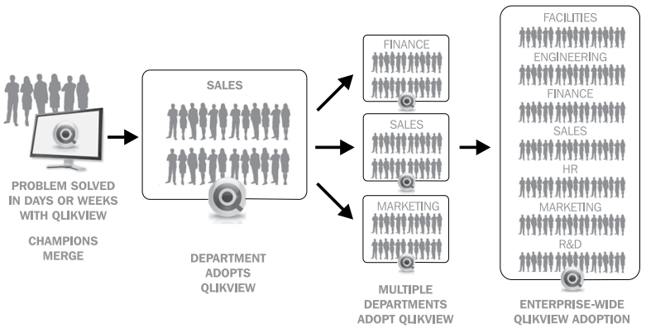
Ways company adopting QlikView

